Slide 1
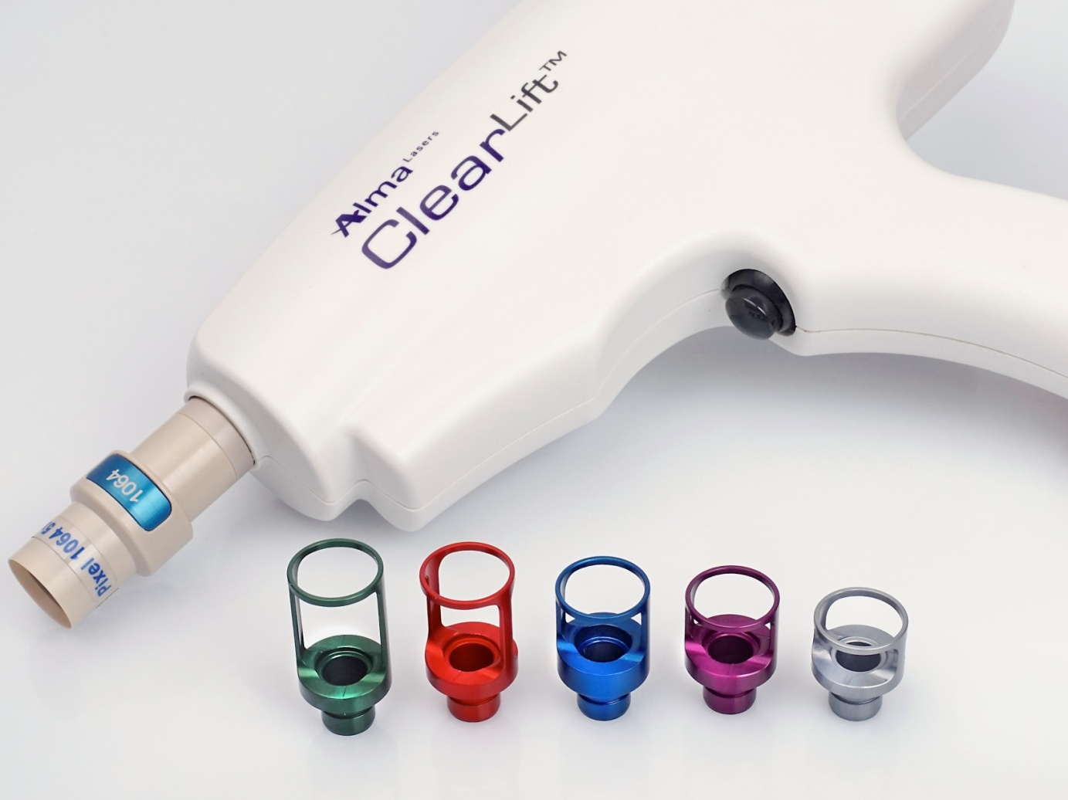

Slide 2
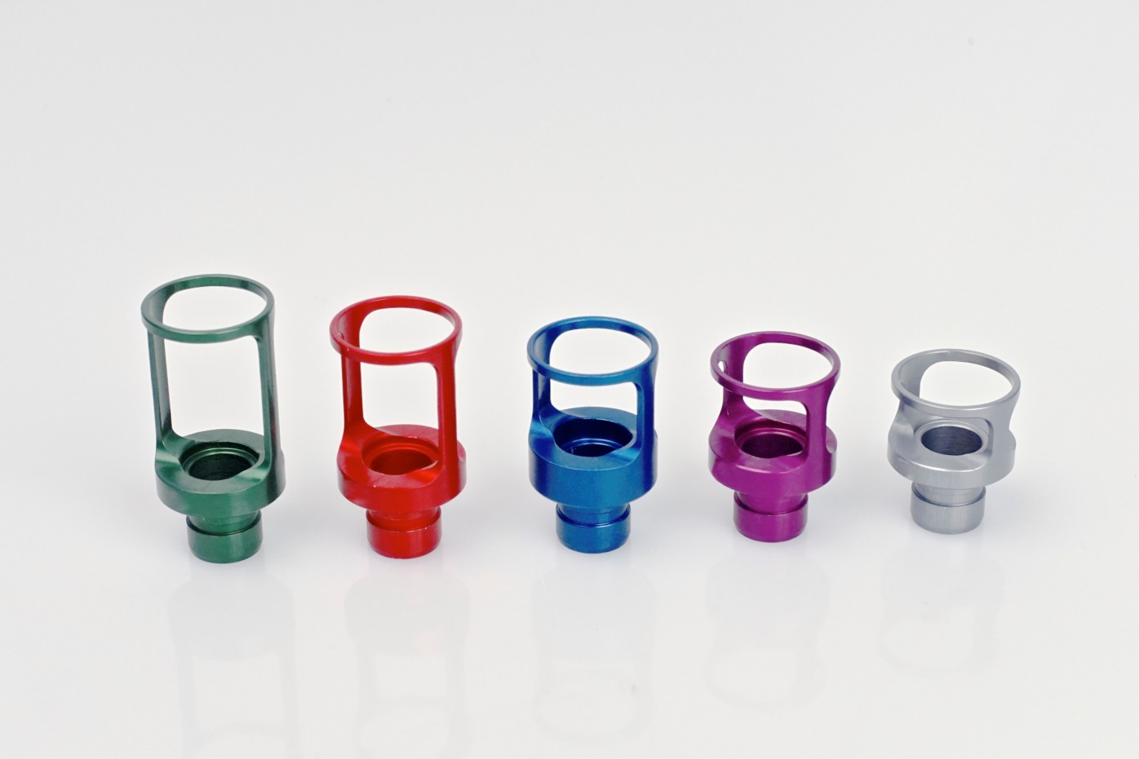
New ClearLift Tips
Superficial
Medium
Deep
+2
+1
0
-1
-2

Slide 3
Primary Indications
Fine-lines & wrinkles
Skin laxity/remodeling
Melasma
Photodamaged and photoaged skin

Slide 4
Mechanism of Action
Photo-mechanical (acoustic/vibration)

Slide 5
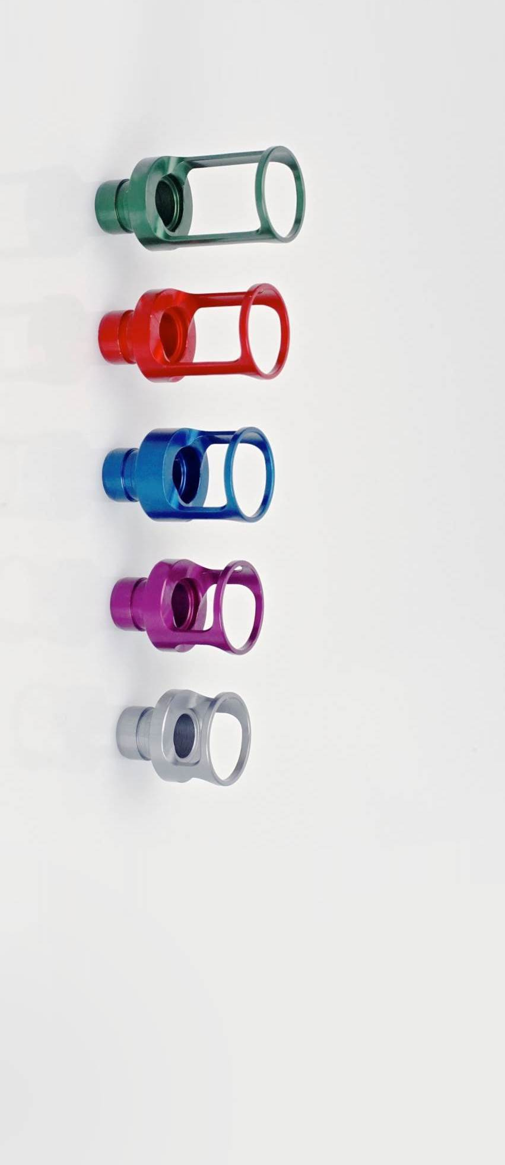
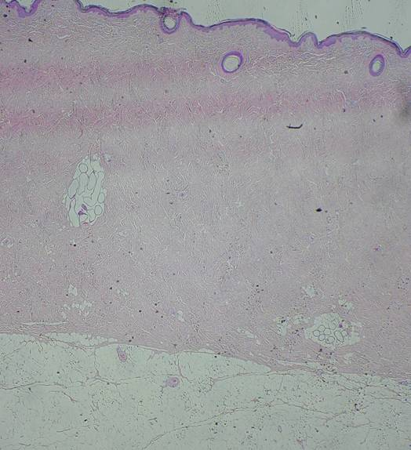
Epidermis = ~0.150mm
Papillary dermis
Mid-upper dermis
Mid-dermis
Dermis = 4~6mm

Slide 6
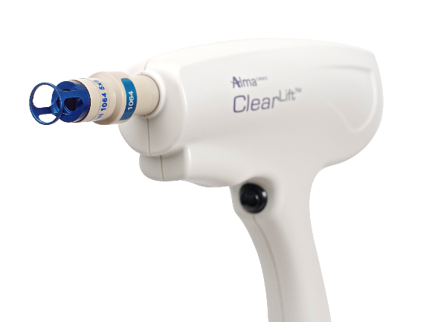
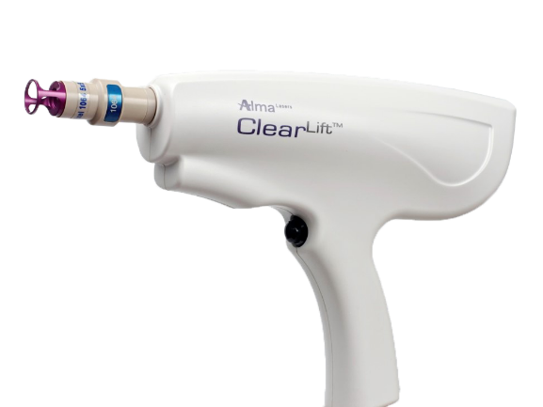
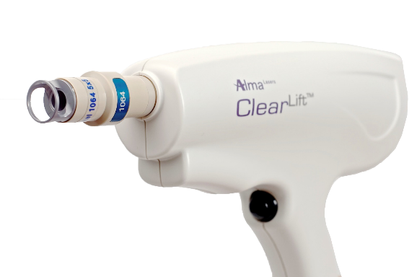
Indications – Deep Tips
Wrinkles
Skin tightening
Photodamage/ Photoaging collagen remodeling
Collagen remodeling
Used in rough skin

Slide 7
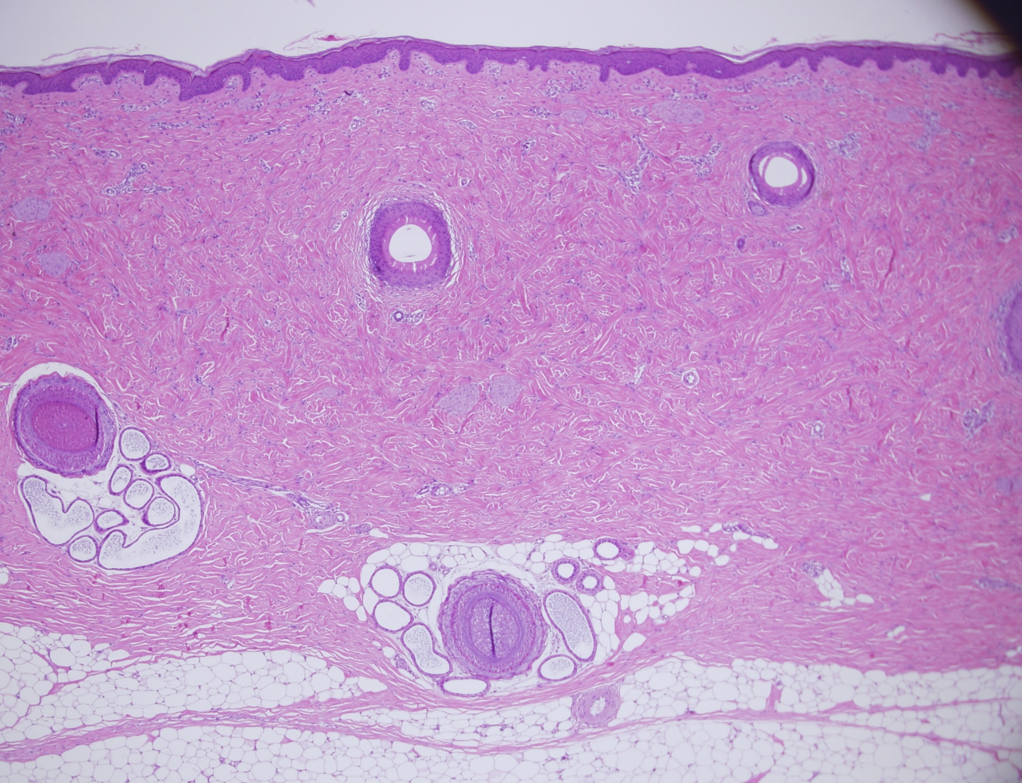
0
-1
~2-4mm
Upper-mid dermis/deep tips
-2
Hypodermis

Slide 8
Protocol – Deep tips
Depth of penetration: 500-1000 microns Skin types I-VI
0
-1
-2
Accumulative Energy (J)* | PRR | Overlapping % | Energy | Gauged Tip
800-1000 | 4 | 50-80 | 1000-1200 | 0, (-1) , (-2)
* Per 20 cm² area

Slide 9
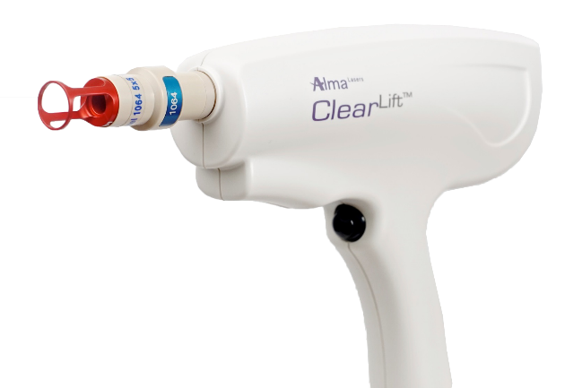
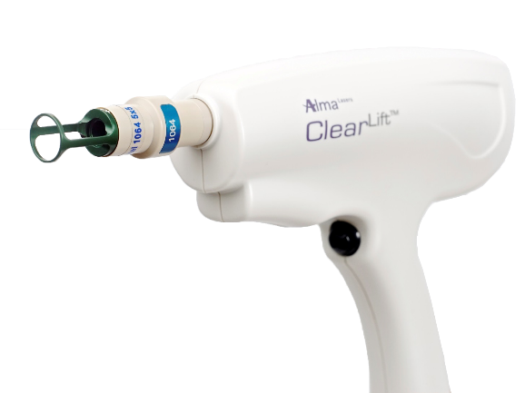
Indications – Superficial Tips
Melasma
Photoaging / pigmentation
Skin Laxity
- Fine Lines

Slide 10
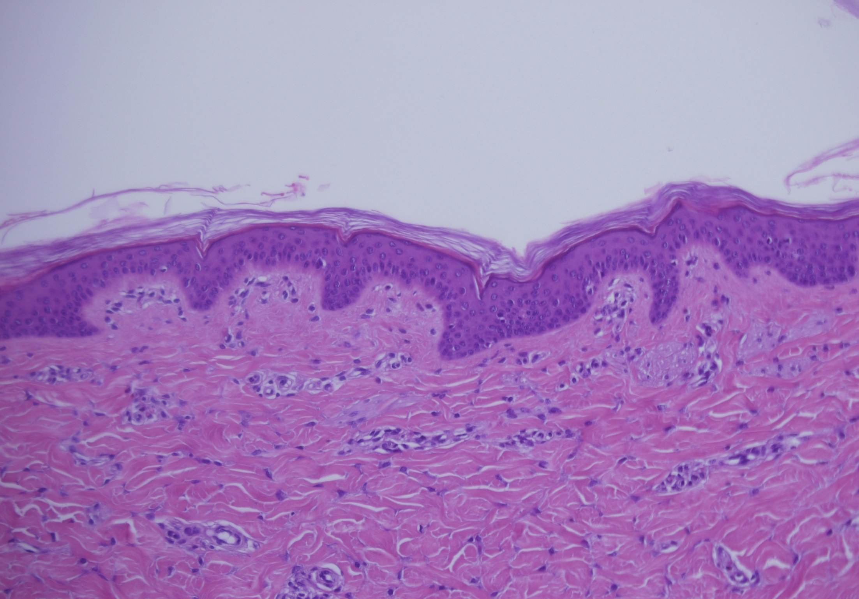
0
+1
+2
10-15μm
sc
50-150μm
epi
~500-600 μm

Slide 11
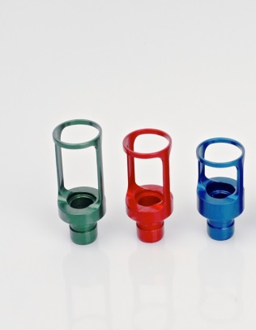
Protocol – Deep tips
Depth of penetration: 100 - 500 microns Skin types I-VI
+2
+1
0
Accumulative Energy (J)* | PRR | Overlapping % | Energy | Gauged Tip | Indications
400-600 | 4 | 50-80 | 800-1200 | (+1), (+2) | Photoaging /Pigmentation
600-800 | 4 | 50-80 | 800-1200 | 0 , (+1) | Skin Laxity
600-800 | 4 | 50-80 | 800-1200 | 0 | Fine Lines
* Per 20 cm² area

Slide 12
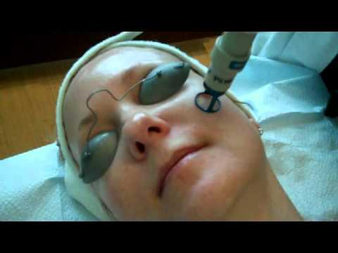
Treatment Approach

Slide 13
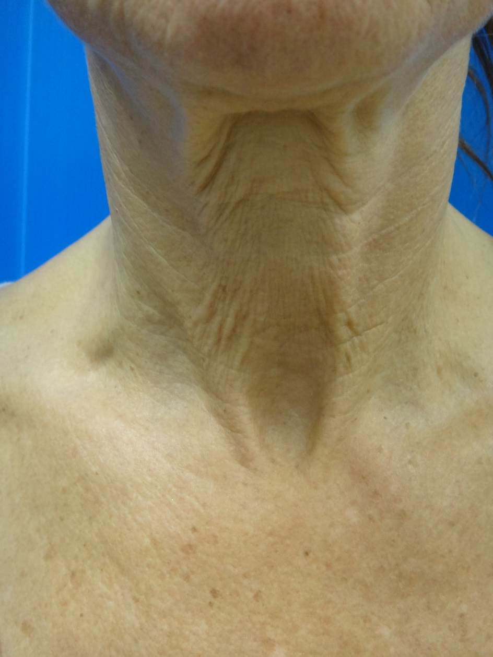

Slide 14
Protocol – Melasma Treatment
Accumulative Energy ( J)* | PRR | Overlapping % | Energy | Gauged Tip | Melasma Type
400-600 | 4 | 50-80 | 400-600 | (+2) | Epidermal
400-600 | 4 | 50-80 | 600-800 | (+1) | EDJ
400-600 | 4 | 50-80 | 800-1200 | 0 | Dermal
* Per 20 cm² area

Slide 15
1
2
3
4

Slide 16
5x4 cm

Slide 17
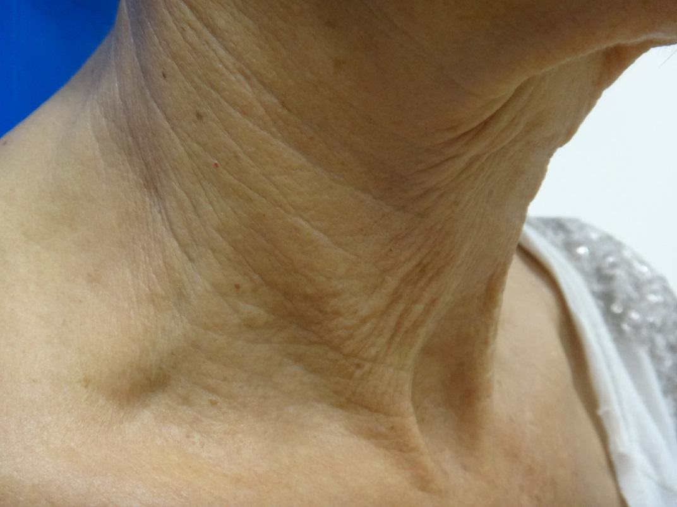
800-1000J
800-1000J

